Slide 1
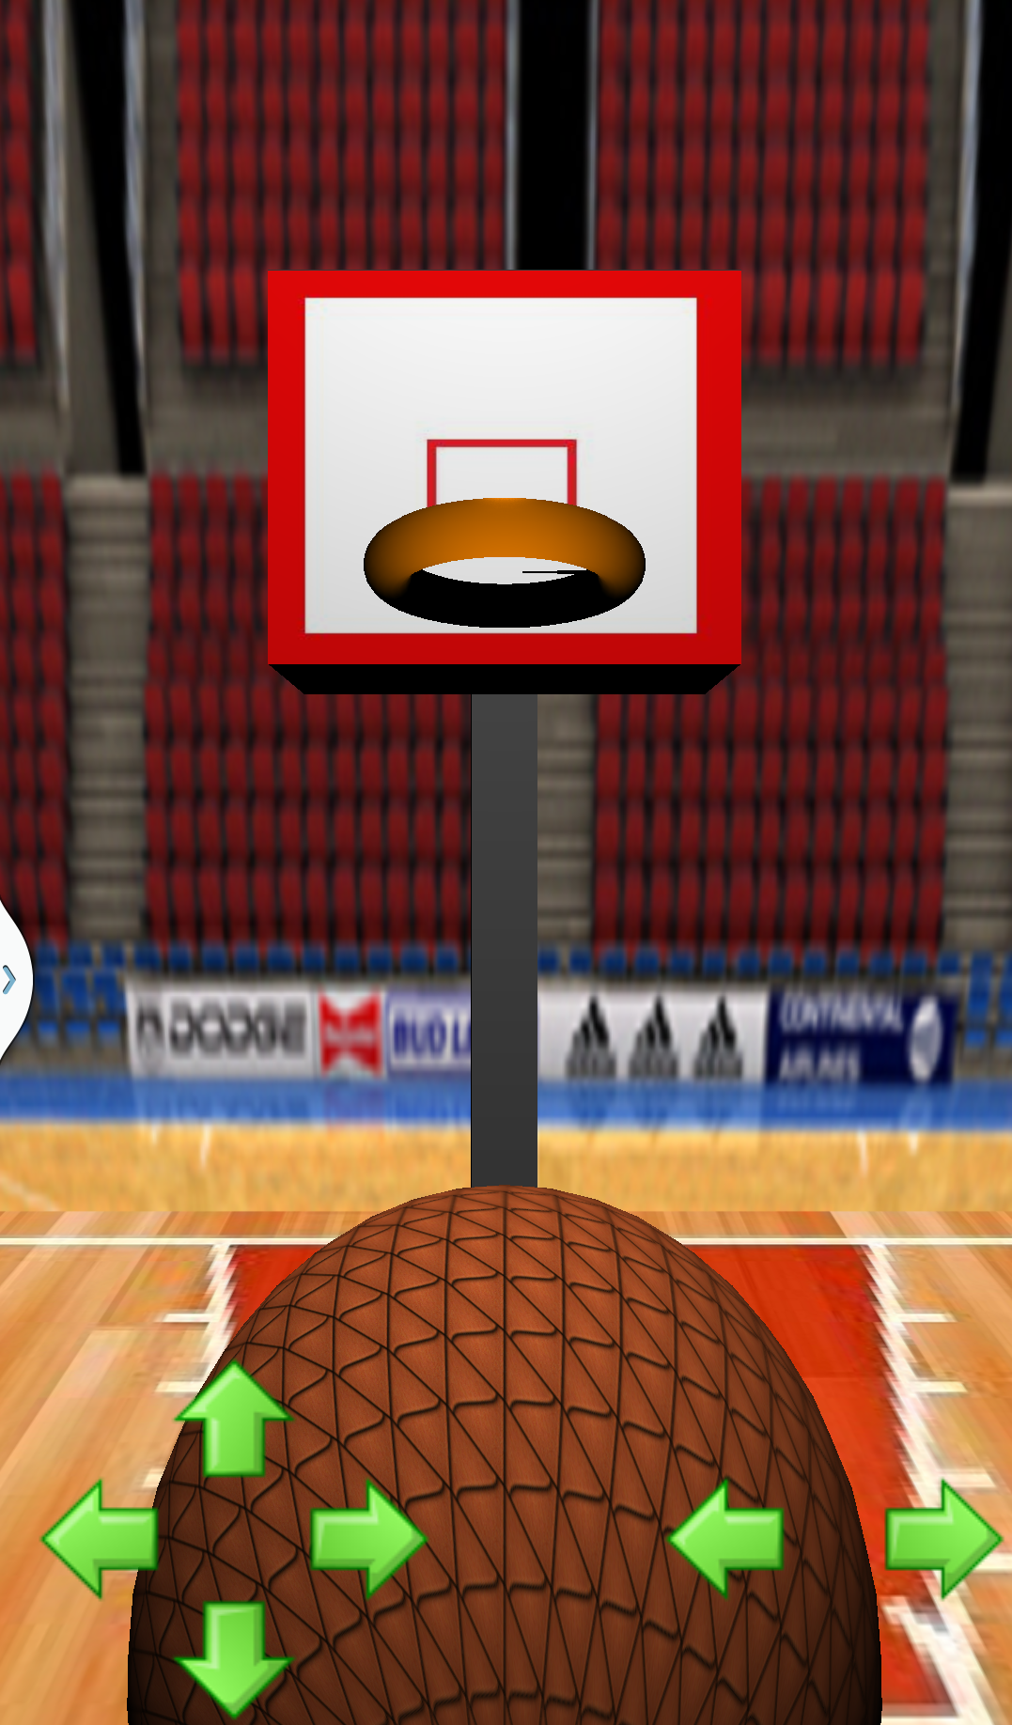
Buckets
Bobby Vandiver
Frank Masby

Slide 2
Implemented Functions
Key functions
Motion detection
onSensorChanged()
Animation
shootBall()
createShotListener()

Slide 3
Implemented Functions
Key functions
Collision detection
collides()
Replay
replayListener()
enableReplay()

Slide 4
Function Implementation
onSensorChanged()
Measure acceleration of device.
shootBall()
Calculate acceleration and velocity of ball using delta value received from onSensorChanged()
Ball is projected on a parabolic curve determined by fling intensity and gravity.
createShotListener()
onComplete()
onSuccess()
onFailure()

Slide 5
Lessons Learned
Motion Detection
Collision Detection
Media Integration
Skybox Integration

